Slide 1
Zeeman Effect Experiment with High-Resolution Spectroscopy for Advanced Physics Laboratory
The Wonderful World of AJP
Dr. Andrew Taylor
Physical Sciences, Inc. Andover, MA
Dr. Oleg Batishchev and Alex Hyde
Department of Physics, Northeastern University, Boston, MA
January 9th, 2018

Slide 2
Abstract
An experiment studying the physics underlying the Zeeman effect and Paschen-Back effect is developed for an advanced physics laboratory. We have improved upon the standard Zeeman effect experiment by eliminating the Fabry-Perot etalon, so that virtually any emission line in the visible spectrum can be analyzed. Emitted light from a ~1T magnet is analyzed by a Czerny-Turner spectrograph equipped with a small-pixel imaging CCD. The experiment was taught as part of the Principles of Experimental Physics course at Northeastern University to a combination of graduate/undergrad students. Zeeman’s original sodium experiment is recreated, and the splitting of argon and helium lines is measured as a function of field strength. The students analyze the proportionality of the splitting magnitude to both the B-field strength and lambda squared. The Bohr magneton is calculated and compared to theory. Student feedback is positive, citing the ability to experimentally witness a quantum mechanical effect.
A. Taylor, A. Hyde, and O. Batishchev, Am. J. Phys. Vol. 85, No. 8 (2017).
Notes:
A permanent magnet Holder for variable B-field strength

Slide 3
History of the Zeeman Effect
In case you missed it in your Modern Physics class…
1896: Pieter Zeeman observed a widening of the sodium D line in the presence of a magnetic field (normal Zeeman effect).
1897: Zeeman observed the line through a polarizer; he found two outer circularly-polarized peaks and a central plane-polarized peak; verified Lorentz’s theoretical predictions.
1898: Thomas Preston observed quartet pattern of lines in a magnetic field (Anomalous Zeeman effect).
1902: Paschen, Runge, and others fine Anomalous Zeeman effect patterns of six, nine, eleven, etc. in atomic spectra.
1925: Schödinger formulates wave equation
1925: Pauli and Heisenberg formulate nascent quantum mechanics to explain the Anomalous Zeeman effect
1926: Uhlenbeck and Goudsmit, Bichowsky and Urey independently discover the intrinsic spin of the electron,
Notes:
A permanent magnet Holder for variable B-field strength

Slide 4
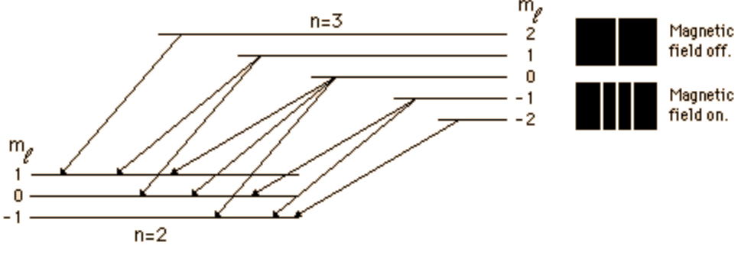
Quantifying the Zeeman Effect
An external magnetic field B exerts a torque on an electron’s magnetic dipole µ and shifts the energy of the atomic level from the non-perturbed energy by $ΔE_{B}=−μ∙B=−μ_{B}g_{L}m_{J}B$
where $g_{L}$ is the Landé g-factor, $μ_{B}$ is the Bohr magneton, and $m_{J}$ is the projection of the total angular momentum J = L + S.
The change in wavelength from a small change in energy $ΔE$ is $Δλ=−\frac{λ^{2}}{hc}ΔE$
Substituting $ΔE=ΔE_{B}$ and $m_{J}=±1$, $Δλ=±\frac{μ_{B}}{hc}λ^{2}B$
For practical laboratory settings, $Δλ=5−20$ pm.
Image sourced from:
http://hyperphysics.phy-astr.gsu.edu/hbase/quantum/zeeman.html
Notes:
B=1.07 T was maximum for the Pasco tubes.
Done for five He I lines and one Ar I line

Slide 5
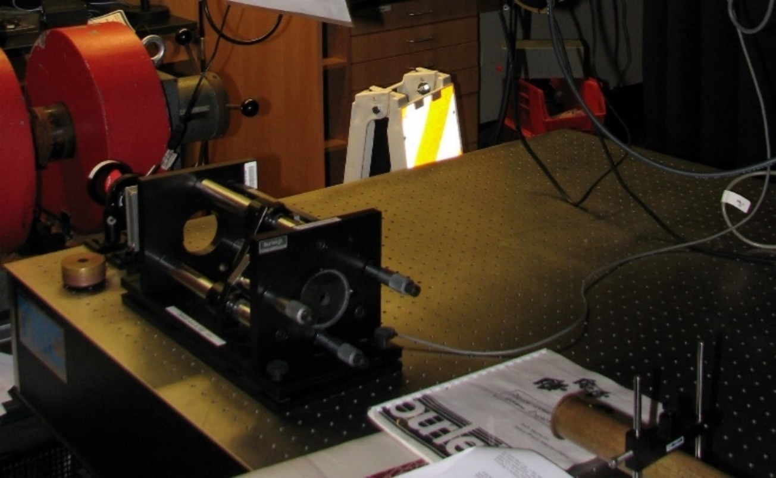
Zeeman Effect in Physics Teaching Lab
Example: Zeeman Experiment at MIT Junior Physics Lab
Understanding the Zeeman effect is important for historic and current research
Experiments introducing the effect are widely used in physics laboratory curricula
Common approach utilizes electromagnets and Fabry-Perot etalon
Requires Reflectivity $R≈0.9$ to resolve splitting of lines
Usually measures only a few spectral lines
Electromagnets and/or etalon require liquid cooling to maintain performance
Replaced Fabry-Perot with high-resolution spectroscopic system that allows measuring the entire spectrum
Replaced electromagnet with permanent magnets with $B\sim$ 1 T
Notes:
With R verified, I applied the instrument towards measuring the Zeeman Effect…
In the process, I developed a new experiment which showcases the strengths of this system.
Water cooled, only run for short periods of time. Room maintained at constant temp due to etalon

Slide 6
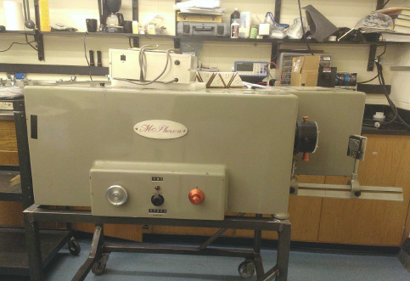
McPherson M216 Spectrometer
Side view of M216 installed in the NEU Plasma Lab
Made by McPherson in 1960s
Used at Harvard Center for Astrophysics
Donated to NEU Plasma Lab in 2014
Asymmetrical Czerny-Turner design
$f$ = 1 m focal length with 1200 g/mm grating
Large 8” collecting and 12” focusing mirrors
Originally designed for 35 mm film
Was retrofitted to deliver high spectral resolution in UV—NIR range with new CMOS camera and collecting optics
Notes:
The spectrometer used for this new approach is a M216…
Retrofitting included four features…
Less dense grating gives a broader spectral range

Slide 7
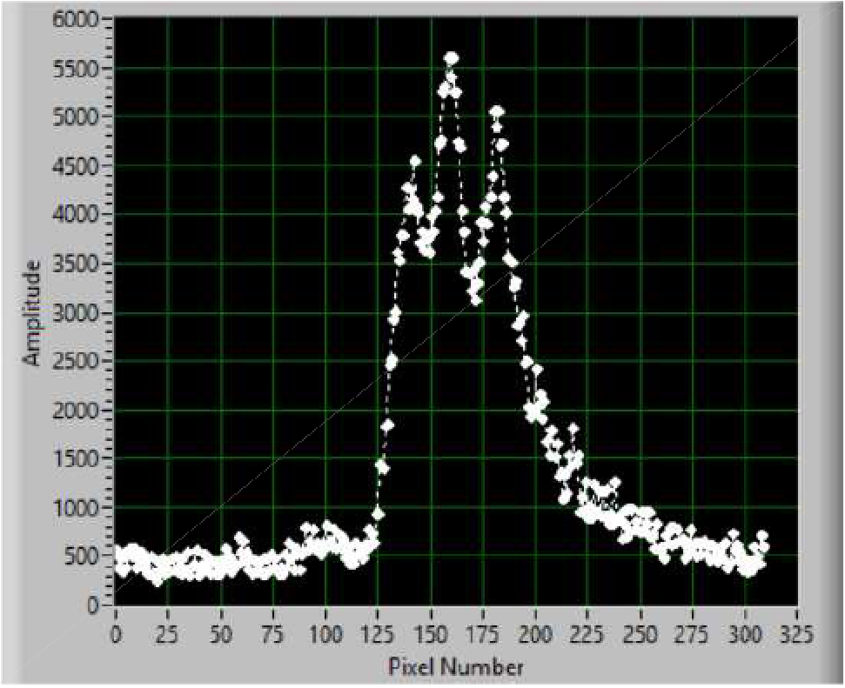
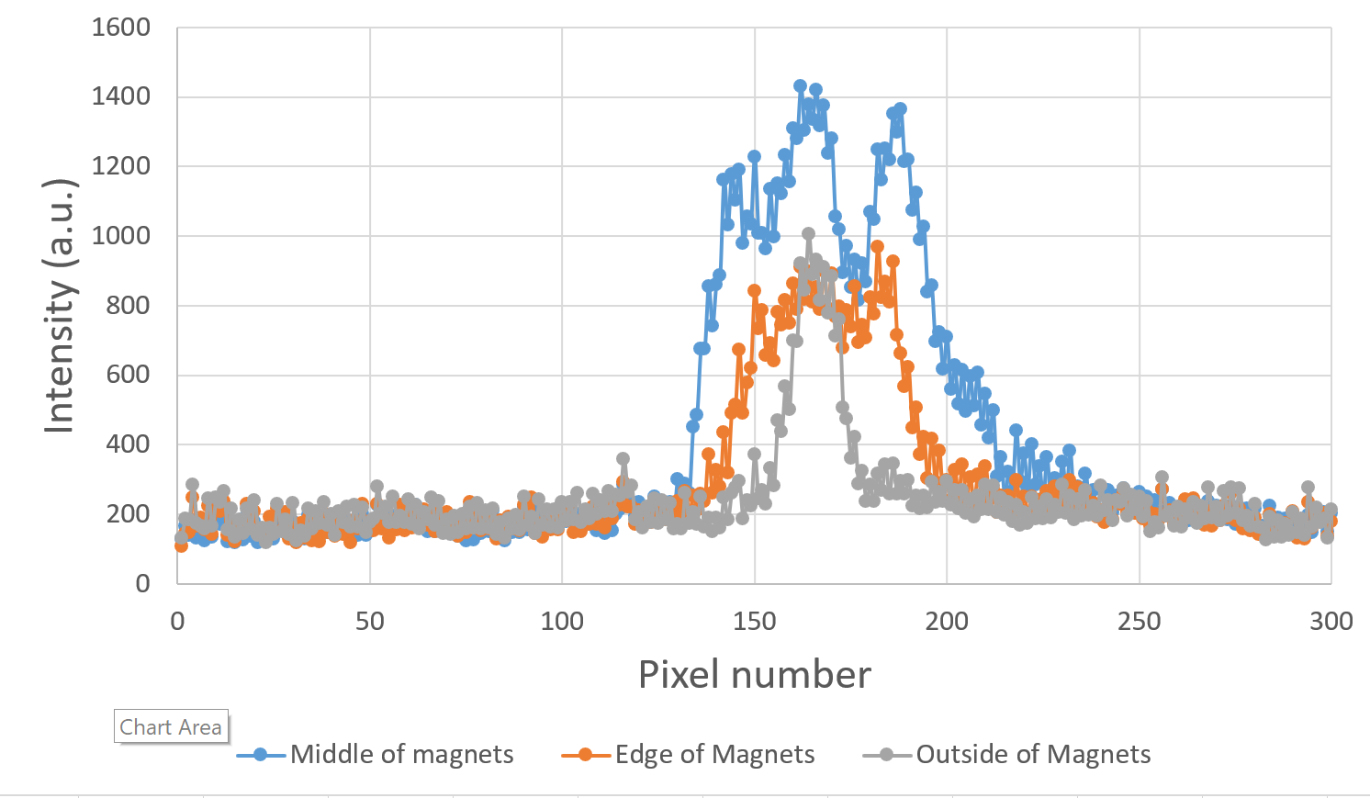
Initial Viability Test of Spectroscopic System
Initial proof-of-concept setup
Tested Resolution in measuring Zeeman Effect using a simple proof-of-concept
Pasco Spectral Tube 50-W discharge tube and 125 V Power Supply
Modified a Pasco Spectral Tube power supply to lay flat, and two attached N50 neodymium magnets created a $B\sim 0.8$ T field at center of tube
Optical fiber pointed in center of field
Observed Zeeman triplet splitting of the He I 706 nm line
MU1403 camera, 5 um slit
Side peaks approx. half of center peak
Initial spectrum of Zeeman Effect
Notes:
A permanent magnet Holder for variable B-field strength

Slide 8
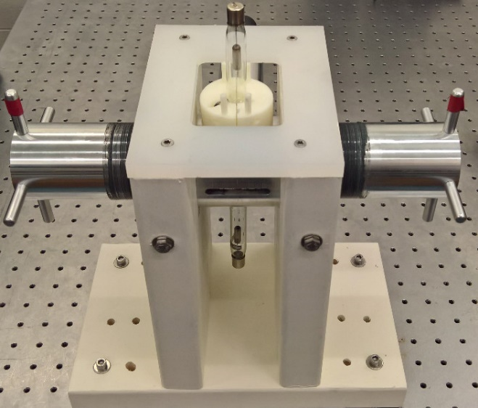
Permanent Magnet Holder for Zeeman Effect
Holder body and arm
Magnet Holder was designed by Prof. Batishchev
Machined by NEU machine shop
Two 8” arms each loaded with a 2” N52 neodymium permanent magnet, remanence $≈1.48$ T at surface
Threaded for 1 mm/rotation travel
Handles added and marked
Rotation of arms in the body varies separation distance $d$
Upper and lower openings through which the light source is placed
Side opening notched for mm-measurements
Sturdy wooden frame cut, assembled, and installed on optical bread board table
3D-printed tube stop on top and bottom to secure light source
Assembled Holder in frame
Notes:
A permanent magnet Holder for variable B-field strength

Slide 9
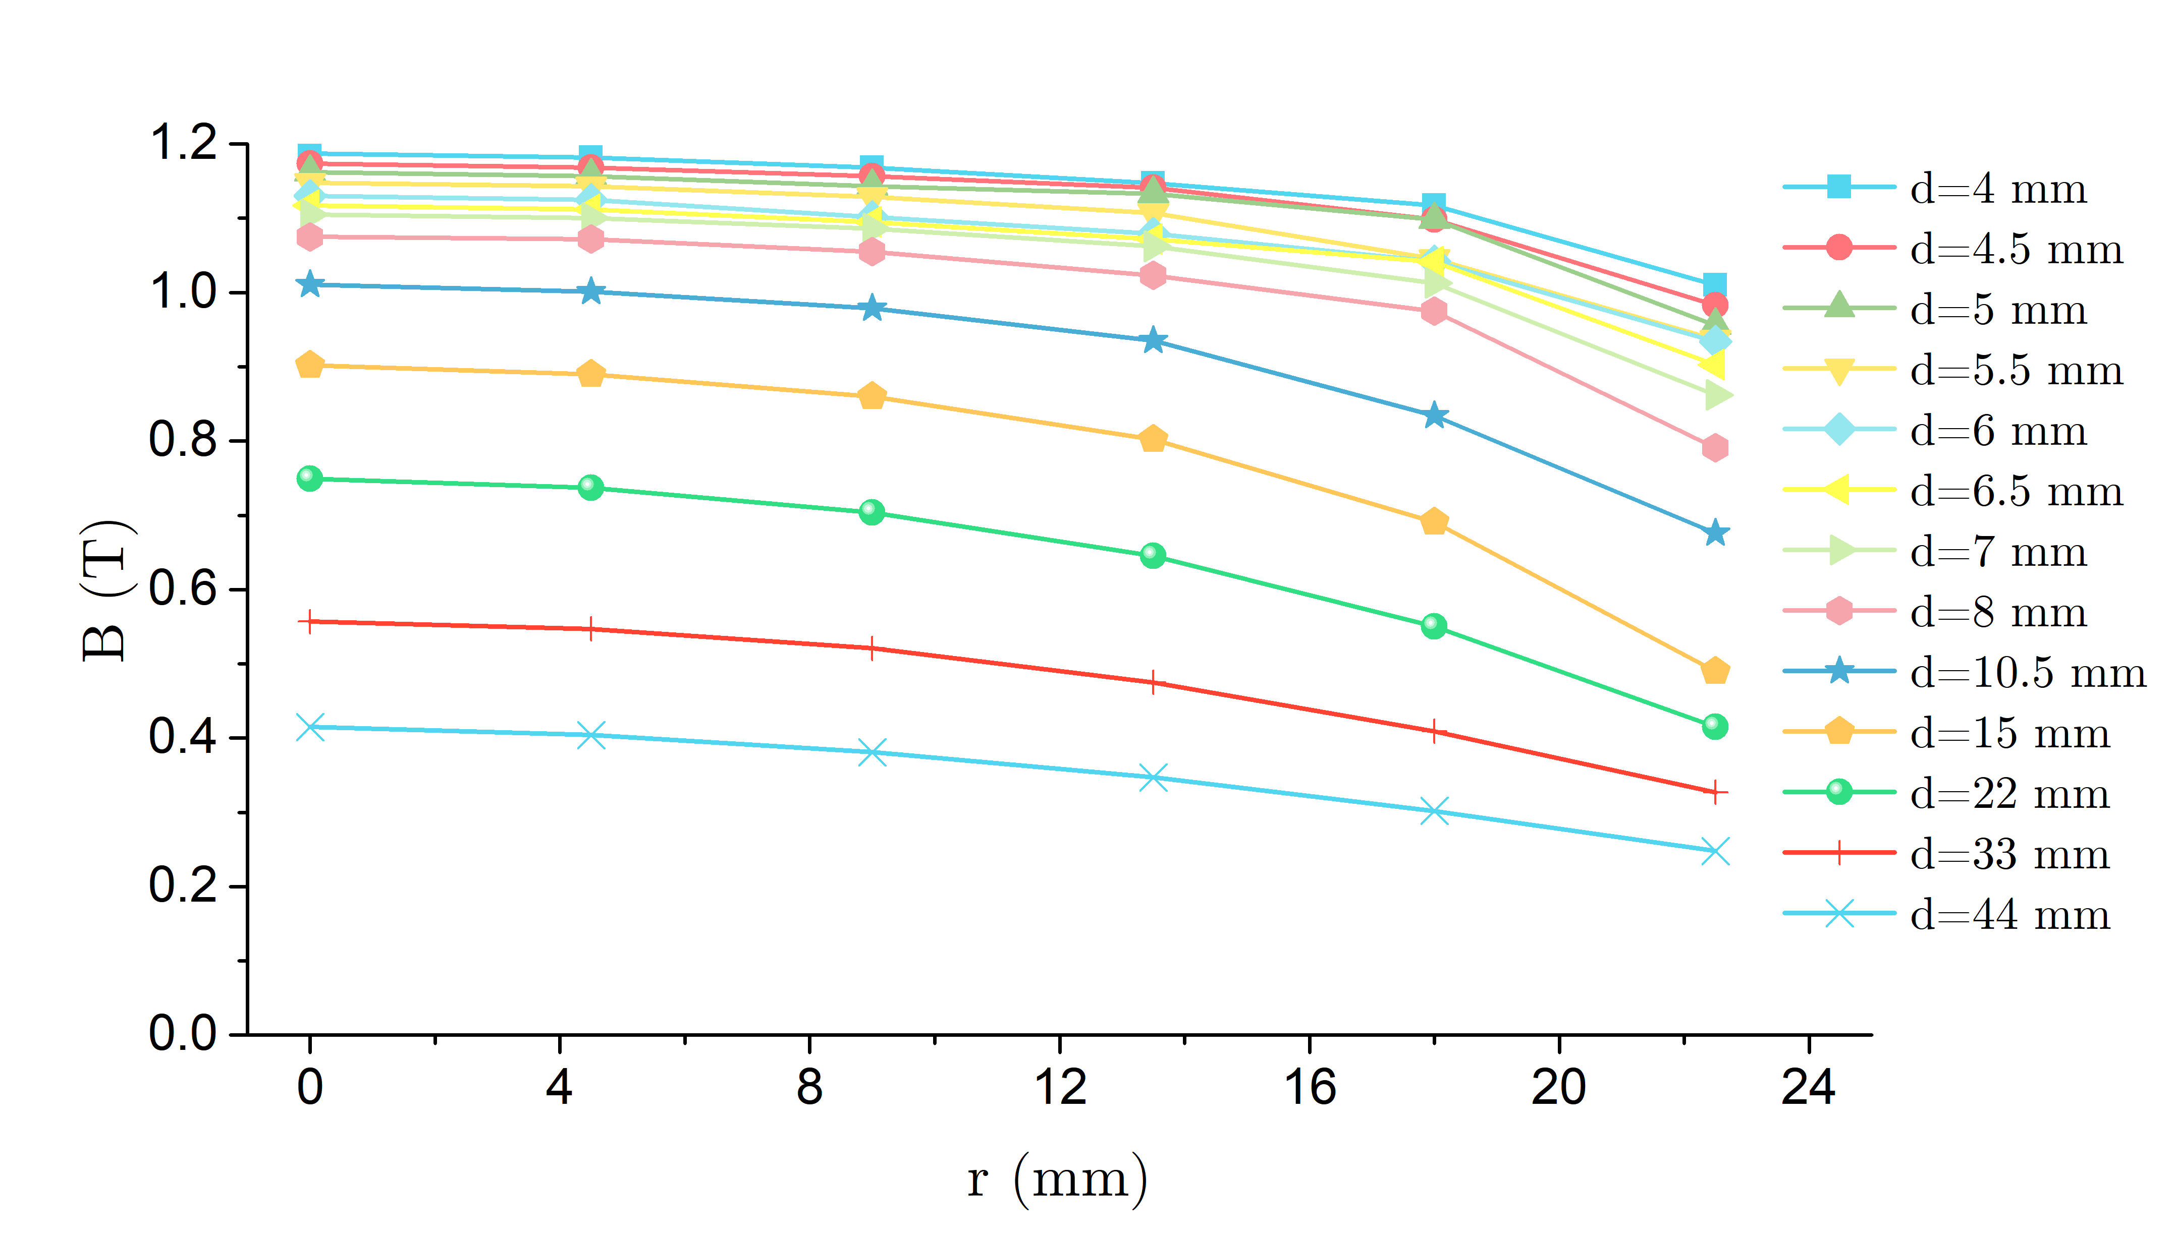
Calibration of B-Field Strength Measurements
Measured Field Strength across the magnet face $r$ at various $d$
Placed the sensor tip of an Alpha Labs gaussmeter on a moveable stage
Made multiple measurements at $r=0, d=8$ mm to determine accuracy
$δB=0.02$ T
For a given $d$, measured $B$ every $r=4.5$ mm, starting at $r=0$
Ran calibration 3x to eliminate possible sensor tip misalignment
Achieves 1.19 T in center
Approx. uniform across face of magnets
Magnetic field at $r=0$ as a function of separation distance $d$
Magnetic field as a function of radial distance from the center for varied $d$
Notes:
A permanent magnet Holder for variable B-field strength
Gaussmeter didn’t *quite* fit through the long, narrow opening, and so the tip would rotate and measure lower flux

Slide 10
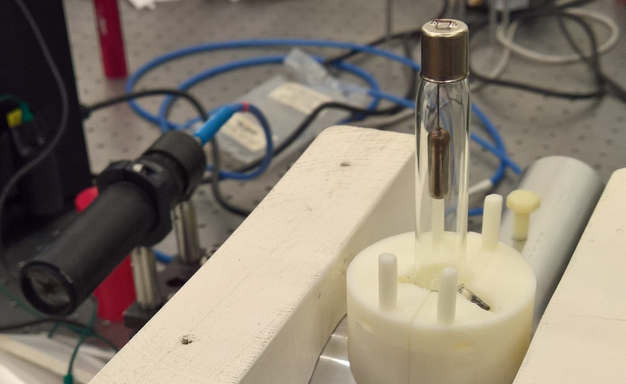
Light Source and Collection Optics
Continued to use Pasco Spectral tubes
Used optical fibers for emission collection from discharge to M216
Cannot bring fiber directly into Magnet Holder, built two-lens collimator
Back $f=30 mm$ lens selected to match the NA of the fiber
Front $f=75 mm$ lens selected to collect light from smallest possible $d$
Retrofitted M216 entrance slit with optical fiber attached
Left: Collimator for collected emission
Right: end tube into which the collimator fit
Notes:
A permanent magnet Holder for variable B-field strength

Slide 11
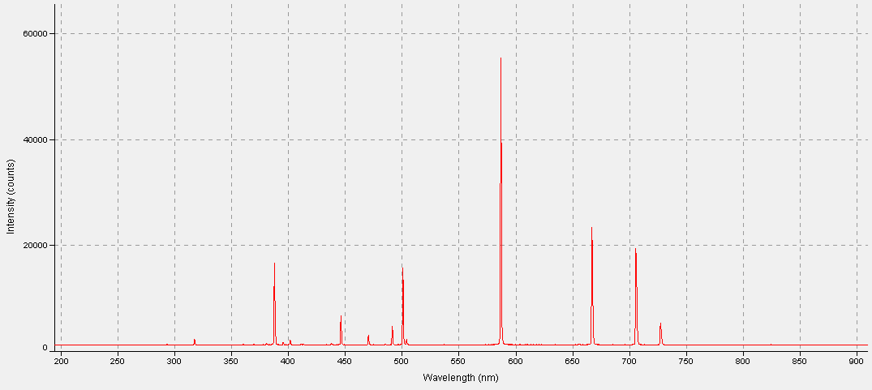
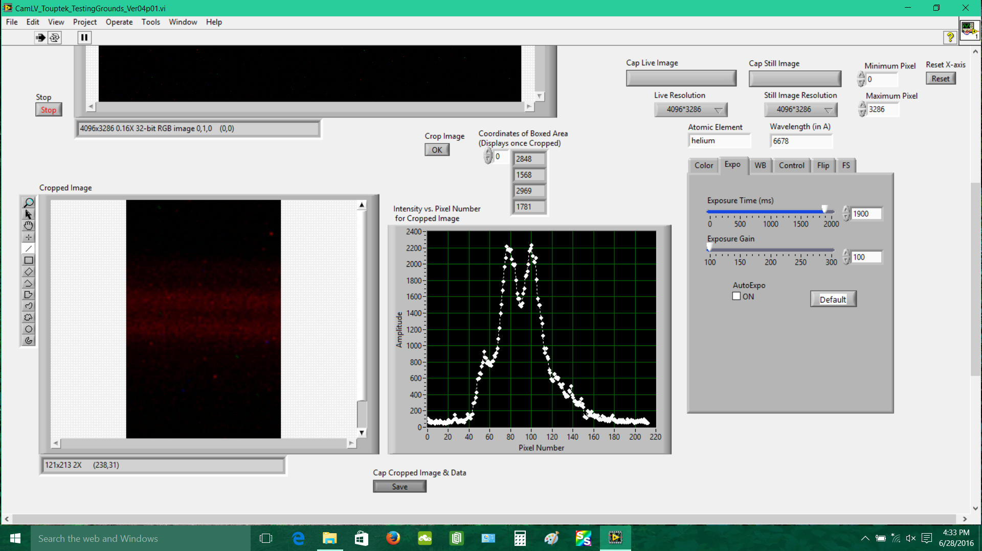
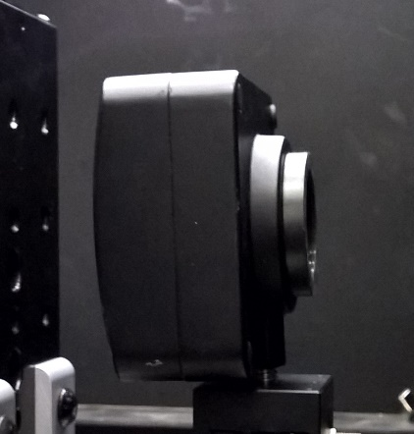
UV-VIS Spectroscopic Systems
Utilized two spectroscopic systems
1:Ocean Optics USB4000 for broad UV—VIS coverage
3648 pixels at 2 nm/pix resolution
2: McPherson spectrometer with Touptek MU1403 14 MP Camera and customized LabVIEW interface
4096 x 3286
~350-1100 nm spectral range
1.4 μm pixel
LabVIEW VI controls integration time, gain, color, etc.
Modified it to integrate image into 1D spectrum and to crop & integrate a small ROI
Notes:
Dispersion is 8.3 A/mm
MU1403 is color, Jenoptik is only B&W but with better sensitivity

Slide 12
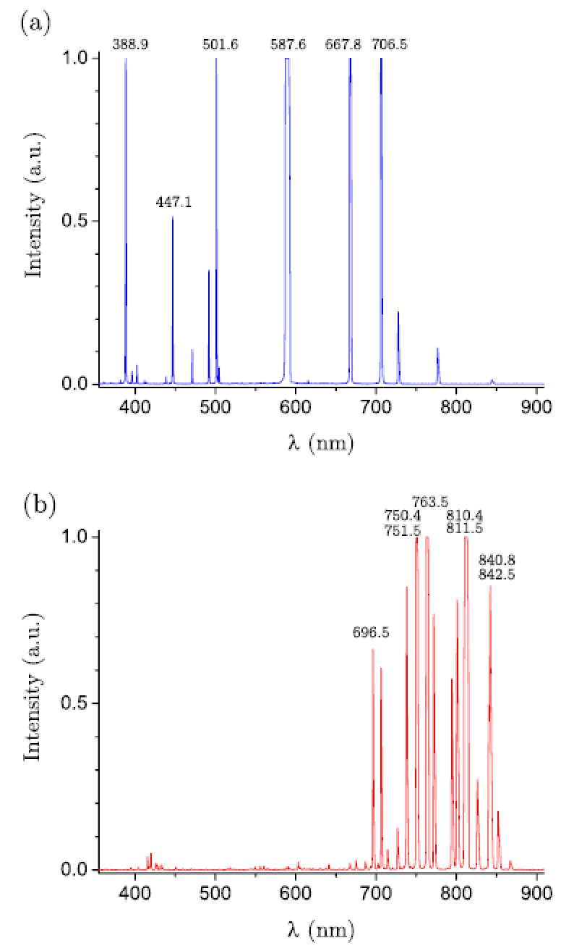
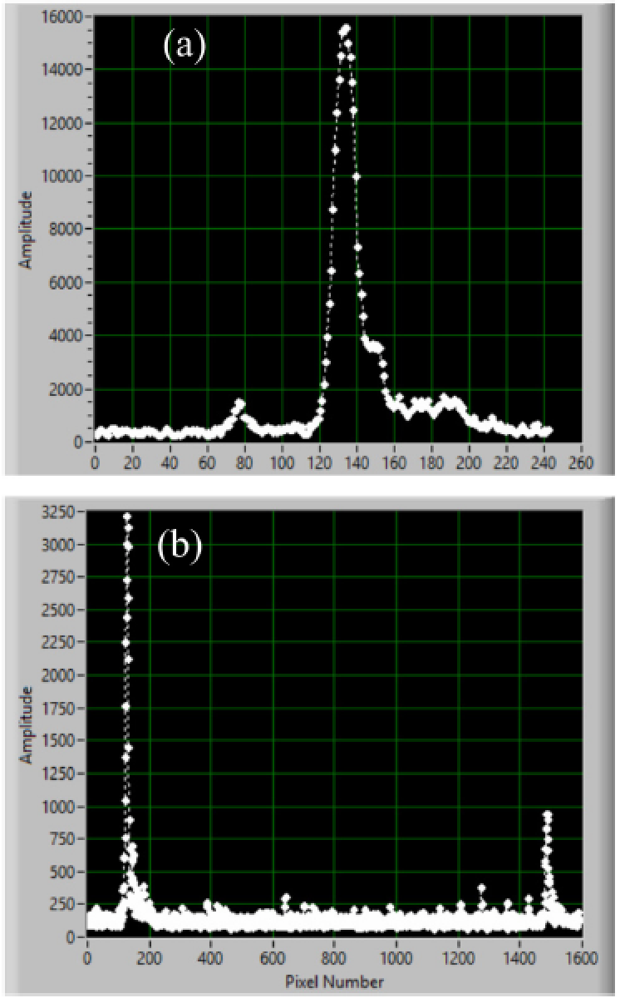
Determination of Spectral Lines
He I and Ar I spectra from USB4000
Calibration using closely-spaced peaks
Helium and Argon ultimately chosen as the sources for Zeeman effect experiment
Single-isotope elements with >99.6% purity
Large number of bright lines across entire UV—NIR spectrum
Utilized closely-spaced peaks at 587, 706, 751, and 811 nm to calibrate the per-pixel resolution
$Δr_{p}≈0.85−1$ pm/pix
Extrapolated resolution for other wavelengths from linear curve
Notes:
B=1.07 T was maximum for the Pasco tubes.
Done for five He I lines and one Ar I line

Slide 13
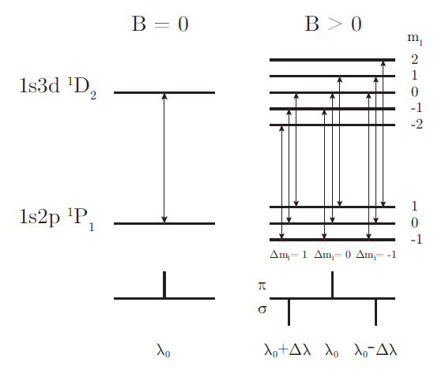
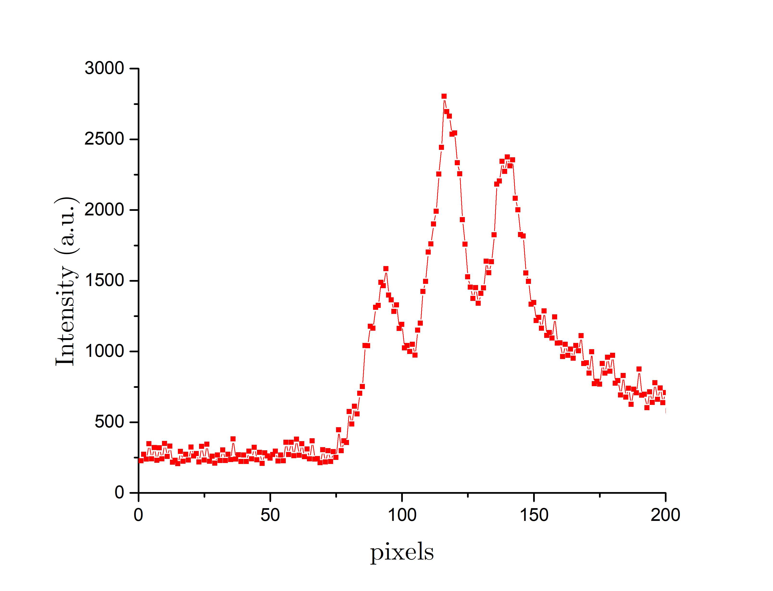
Zeeman Effect in Singlets
Schematic of Zeeman splitting in He I 667 nm singlet transition
He I 667 nm at $B=$ 1.07 T
Measured Zeeman splitting of a line as $B$-field varied from 0.5—1.07 T in 0.1 T increments
Distance values of $d=8, 14, 18, 22, 26, 34$, respectively
Measured in He I 501 and 667 nm, and Ar I 811 nm singlets
Image taken from PHYS5318 lab manual.
Notes:
B=1.07 T was maximum for the Pasco tubes.
Done for five He I lines and one Ar I line

Slide 14
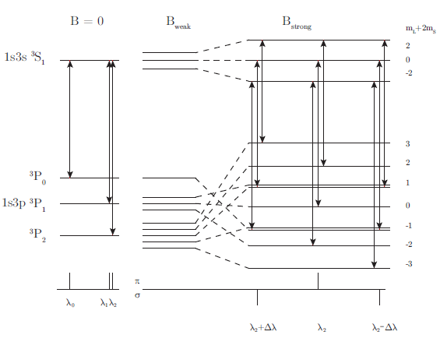
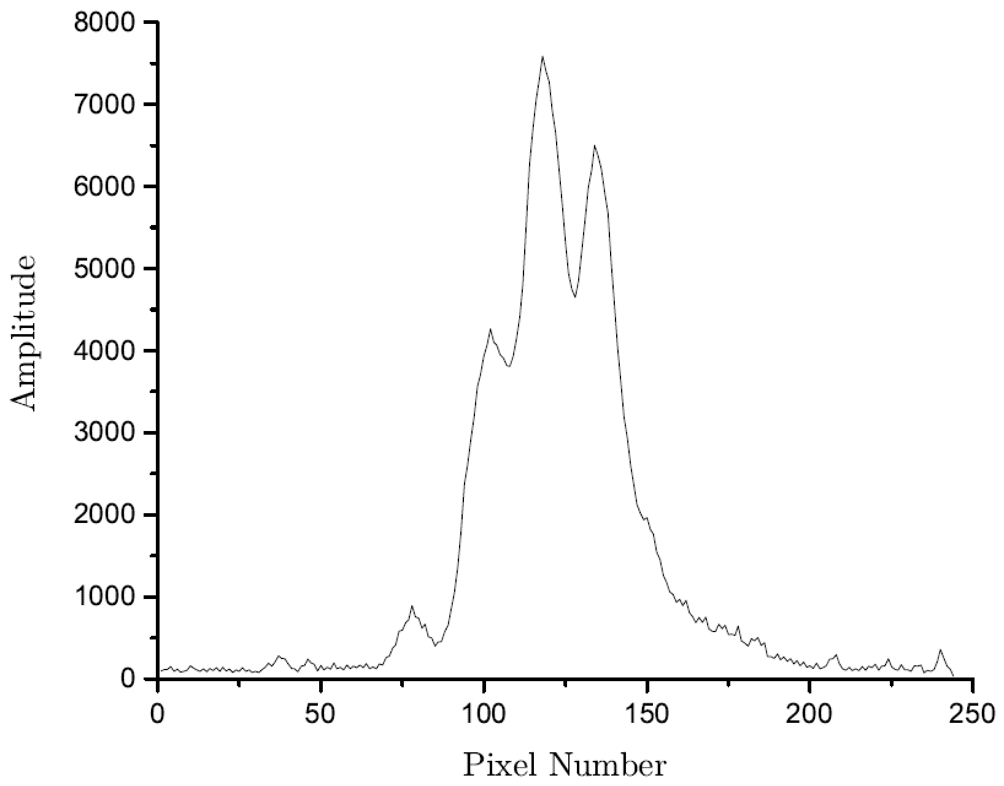
Zeeman Effect in Triplets
Schematic of Zeeman splitting in He I 706 nm triplet transition at Paschen-Back Limit
He I 587 nm at $B=$ 1.07 T
In the strong field limit, $L$and $S$ decouple and interact independently with the field
All transitions converge to exhibit normal Zeeman triplet with $g_{L}=1$
Effect appears when $ΔE_{B}>E_{SO}$
In helium this occurs around B ~ 0.4 T
The limit observed in He I 388, 447, 587, and 706 nm triplet lines
H. Odenthal et al. Physica,113C 203-216 (1982).
Image taken from PHYS5318 lab manual.
Notes:
B=1.07 T was maximum for the Pasco tubes.
Done for five He I lines and one Ar I line

Slide 15
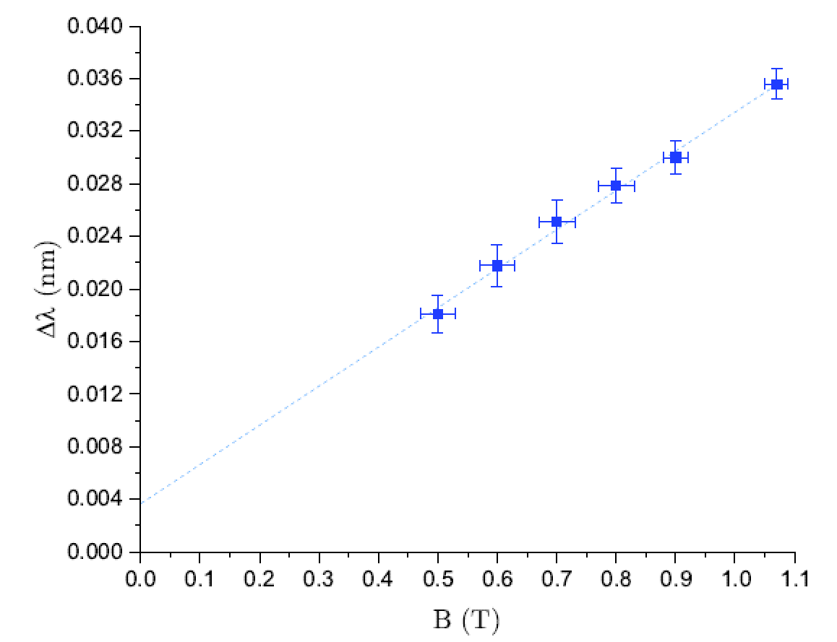
Study of B-field Dependence
Observed Zeeman splitting of a line as $B$-field varied in 0.1 T increments from $B=0.5−1.07$ T
Collected 5x images for each $B$ to gather experimental uncertainty in $Δλ$
Analyzed pixel spacing for left and right peak via LabVIEW cursor, averaged for $Δp±δΔp$
Converted into $Δλ±δΔλ$ via measured $Δλ_{p}$
Graphed $Δλ$vs. $B$ for six He I VIS lines and one Ar I line
From lines, calculated Bohr magneton value with average accuracy of $\sim$10%
$Δλ$ vs. $B$ for He I 587 nm
$Δλ$ vs. $B$ for Ar I 811 nm
Bohr Magneton calculation accuracy
Notes:
B=1.07 T was maximum for the Pasco tubes.
Done for six He I lines and one Ar I line

Slide 16
Study of λ² Dependence
Unique Ability of System
Spectroscopic System has unique ability to measure the $λ^{2}$ dependence of Zeeman splitting
Analysis is available for virtually any line in the VIS spectrum
Used six He I lines from 388—706 nm at $B=1.07$ T
Bohr magneton calculation is more accurate and precise using this new method
$Δλ$ vs. $λ^{2}$ for He I discharge at $B=$ 1.07 T
Notes:
Proportional to B with wavelength fixed, but also proportional to lambda^2 with B fixed.
This system has the unique ability to study that proportionality.

Slide 17
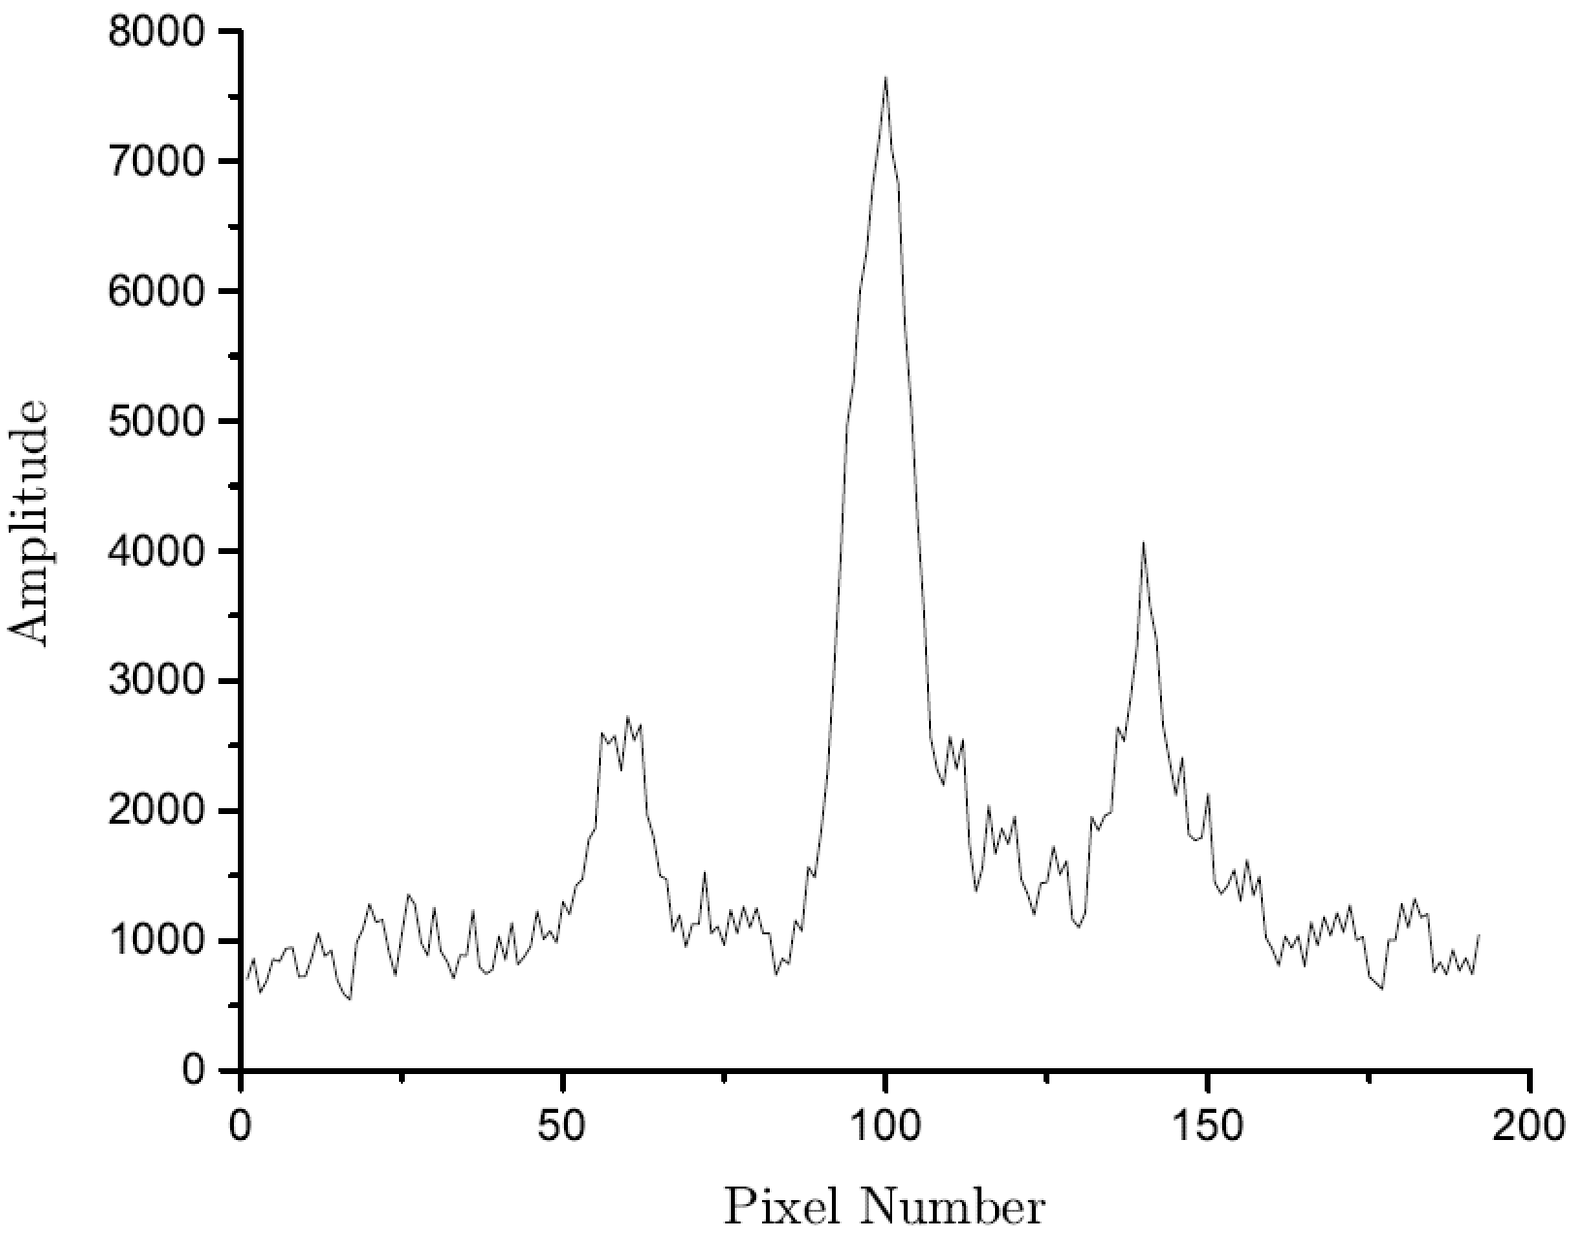
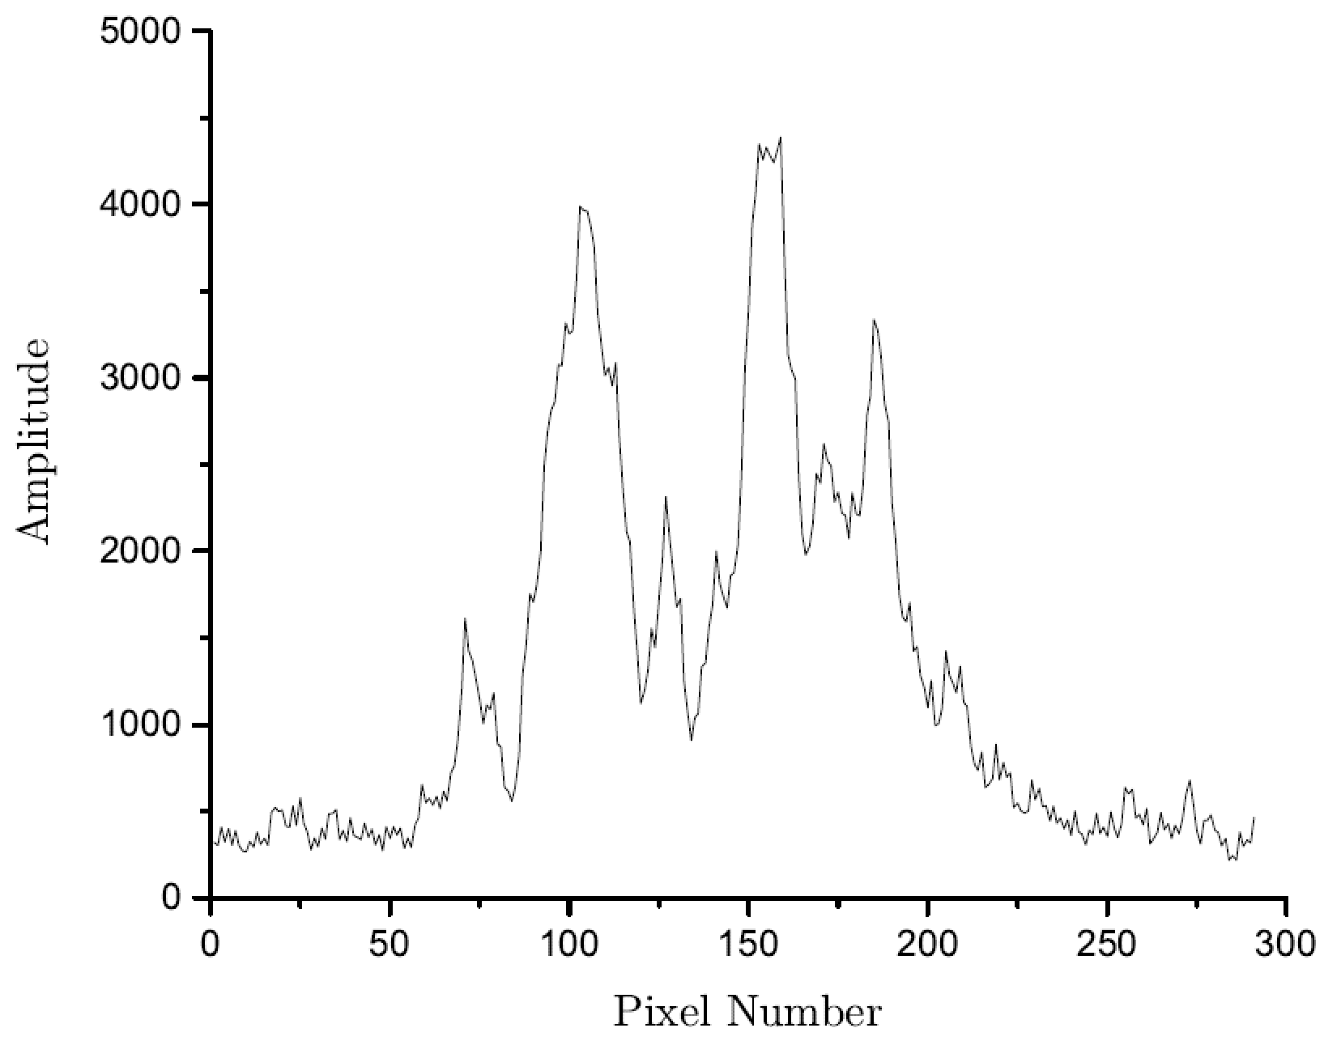
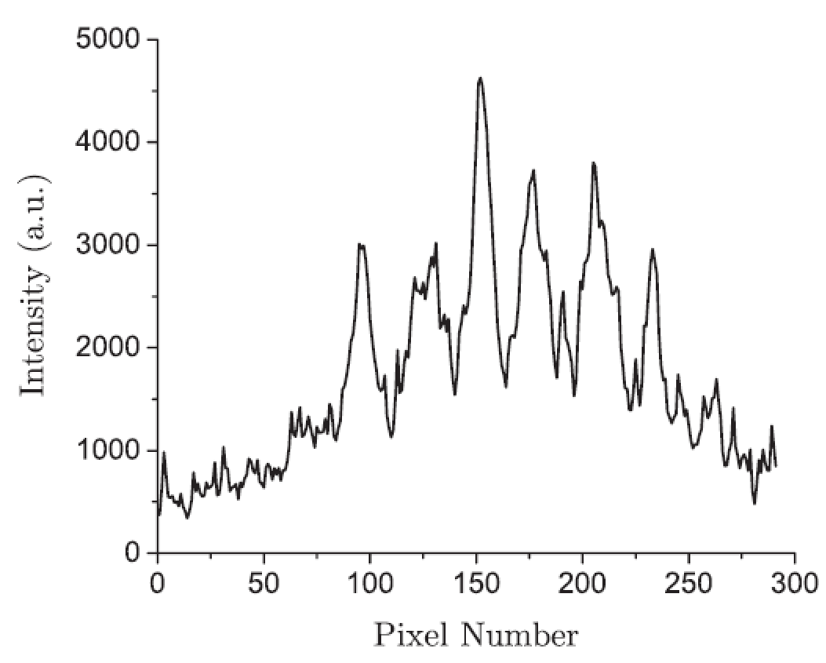
Anomalous Zeeman Effect in Argon
Ar I 696 nm at $B=$ 1.07 T
Ar I 810 nm at $B=$ 1.07 T
Most argon lines exhibit the Anomalous Zeeman effect (not Paschen-Back)
Triplet patterns of $J=1→0$ with $g_{L}>1$, e.g. Ar I 696 nm
Quartet patterns of $J=P_{1/2}→S_{1/2}$, e.g. Ar I 810 nm
Sextet patterns of $J=P_{3/2}→S_{1/2}$, e.g. Ar I 912 nm
Excellent candidate to teach the Anomalous Zeeman splitting, either in conjunction with helium or as a separate experiment
Ar I 912 nm at $B=$ 1.07 T
Notes:
B=1.07 T was maximum for the Pasco tubes.
Done for five He I lines and one Ar I line

Slide 18
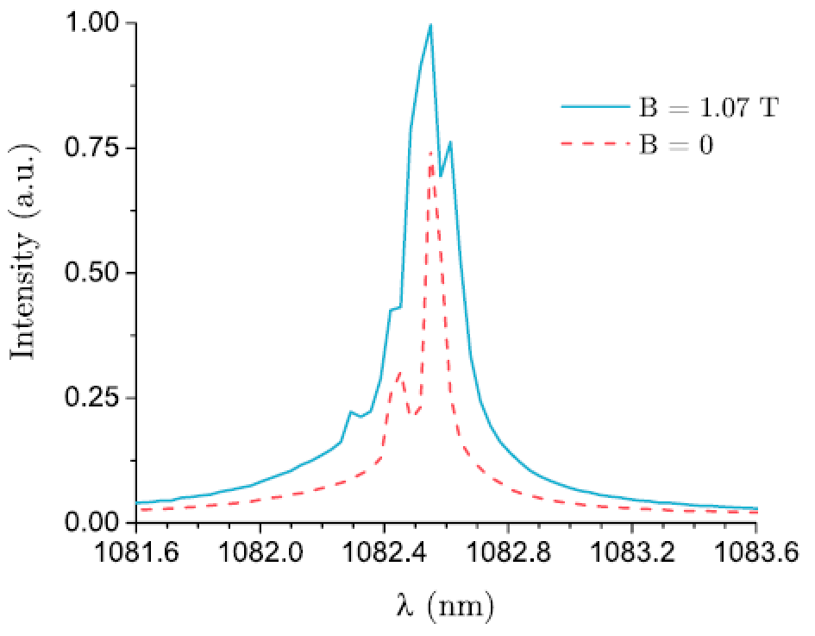
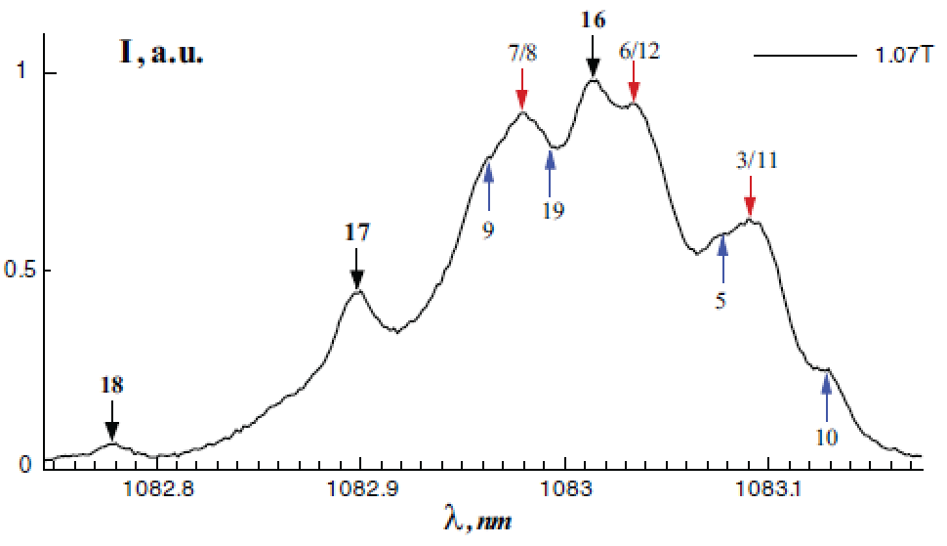
Improvements and NIR Extension
Increasing groove density will increase per-pixel resolution but decreases the longest viewable wavelength
Maximum Zeeman split magnitude $p′$ decreased from current magnitude $p$ by $p^{′}=p/n$
where $n$ is the ratio between 1200g and new grating
The bright He I 1083 nm triplet represents ~135% increasing in Zeeman split over He I 706 nm
Two systems used to measure lines
Princeton Instruments IsoPlane 320 with 1200-g/mm grating and 20 $μ$m pixels
McPherson M216 + MU1803-FL camera with 1.85 $μ$m pixels
A. Taylor and O. Batishchev, Can. J. Phys. 95: 993-998 (2017).
Notes:
B=1.07 T was maximum for the Pasco tubes.
Done for five He I lines and one Ar I line

Slide 19
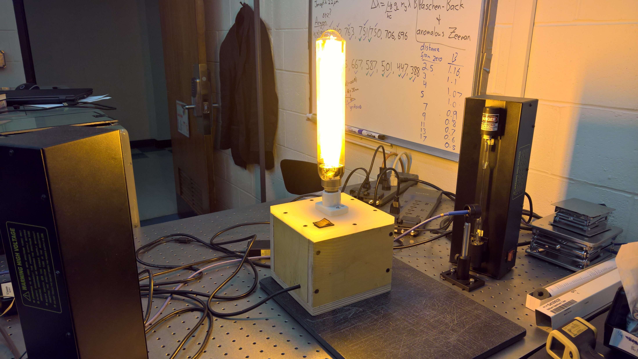
Designing the APL Experiment
Experiment created using the Magnet Holder, USB4000 & M216 + MU1403 spectrometers, and helium & sodium tubes
Designed it around calculating $μ_{B}$ from both $B$- and $λ^{2}$-dependencies of the normal Zeeman and Paschen-Back effects
Re-create Zeeman’s original sodium lamp experiment, showing widening of Sodium D line
Study $B$-dependence using three helium lines (He I 587, 667, 706 nm)
Study $λ^{2}$-dependence using four helium lines at $B=1.07$ T (He I 587, 667, 706, and 1083 nm)
Designed lab manual and lab report grade guide
Sodium lamp used to re-create Zeeman’s original findings
Notes:
B=1.07 T was maximum for the Pasco tubes.
Done for five He I lines and one Ar I line

Slide 20
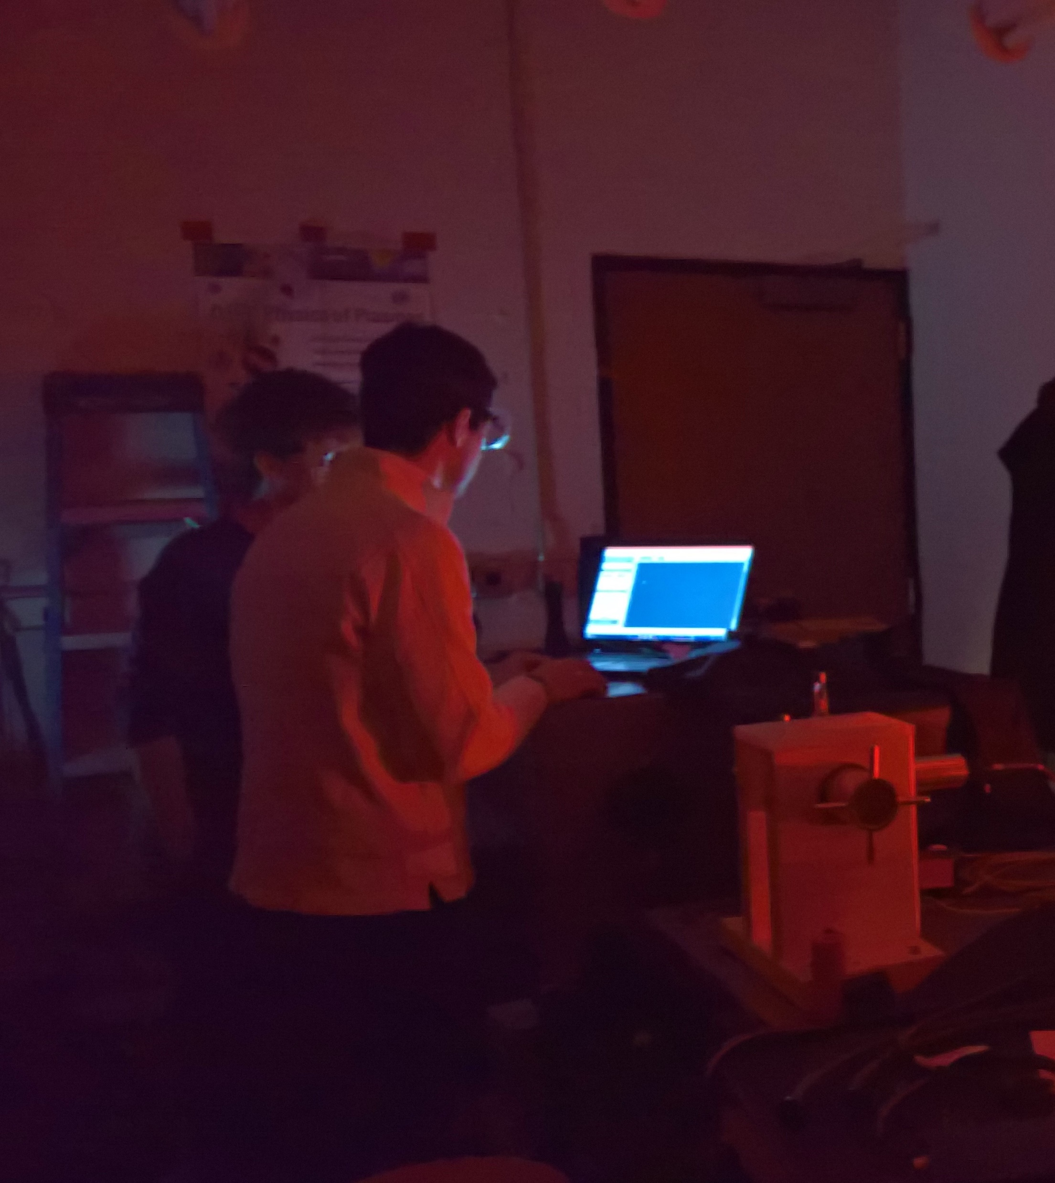
Teaching the APL Experiment
Taught experiment for PHYS5318 – Introduction to Experimental Physics at Northeastern University in Spring 2017
Total of 14 students, both grad and undergrad, across 14-week semester
Two 3-hour lab sessions
Generally 1st to take broad He I and Na I spectra, high-res Sodium D broadening, and some high-res He I Zeeman effect spectra
2nd to take the rest of the He I spectra and analyze the pixel spacing between peaks
Graphing, calculation of $μ_{B}$, and report done outside of class time
Overall positive student outcome with the experiment
High comprehension of what to do, mixed comprehension of why it was done
Best comment: “I’ve never done an experiment that explained Quantum Mechanics so well! I think I finally get it!”
Improvements: start the lab manual with the detailed theory; cut out one or two He I $Δλ vs. B$ parts; provide more motivation for finding $μ_{B}$ two ways
Notes:
B=1.07 T was maximum for the Pasco tubes.
Done for five He I lines and one Ar I line

